Slide 1

HOTEL MANAGEMENT SYSTEM
ABES ENGINEERING COLLEGE GHAZIABAD
DEPARTMENT OF COMPUTER SCIENCE
Presented by
Satyam Gupta
1900320150045

Slide 2
.NET FRAMEWORK
The .NET Framework is a software framework developed by Microsoft that runs primarily on windows.
It includes a large library and provides language interoperability (each language can use code written in other languages).
Programs written for the .NET Framework execute in a software environment known as the Common Language Runtime (CLR).
The class library and the CLR together constitute the .NET Framework.
Basically one can think runtime as an agent that manages code at execution time, providing core services such as memory management etc.
Notes:
How presentation will benefit audience: Adult learners are more interested in a subject if they know how or why it is important to them.
Presenter’s level of expertise in the subject: Briefly state your credentials in this area, or explain why participants should listen to you.

Slide 3
.NET FRAMEWORK CLASS LIBRARY
The class library is object oriented.
Rather than accomplishing common programming tasks such as data collection, Database connectivity and file access.
In addition to these common tasks .NET framework is used to develop the following types of applications and services :-
Console applications
Windows GUI applications(windows Forms)
ASP.NET applications (Web development) and etc.
Notes:
Lesson descriptions should be brief.

Slide 4
.NET FRAMEWORK OBJECTIVES
Supports platform independent concepts
Supports language independent concepts
Supports language interoperability concepts
Supports pure OOPS concepts
Supports to work with databases
Supports to develop game programming
Supports to work with link programming(when link program is compiled then SQL for the database are automatically generated)
Notes:
Example objectives
At the end of this lesson, you will be able to:
Save files to the team Web server.
Move files to different locations on the team Web server.
Share files on the team Web server.

Slide 5
HOTEL MANAGEMENT INTRODUCTION
This project introduces THE HOTEL MANAGEMENT SYSTEM. It explains how seat booking is done in a hotel. Generally in a hotel seat booking in a hotelcan be of two types:Current Booking.Advanced Booking.
On the other hand there has to be a check out system for those seats which hadbeen booked before hands and are to be left out now.The Hotel Department maintains the seat availability and booking details in a certain Database. It contains the details of the different rooms available in that particular hotel, for instance there might be rooms with A.C, and non A.C. facilities which might further be classified into single, double and triple bedrooms.
The Database also consist a record of the seats that are already booked and theones yet to be booked.A bright feature of this software is the inclusion of The Time Scheduling feature, which makes it more user friendly, more efficient and provides it high flexibility.

Slide 6
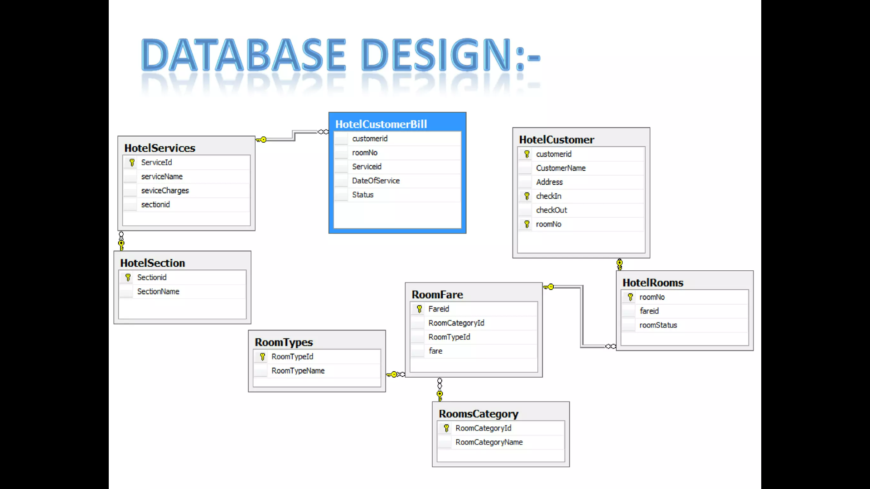
DATABASE DESIGN

Slide 7
SNAPSHOTS OF THE PROJECT

Slide 8
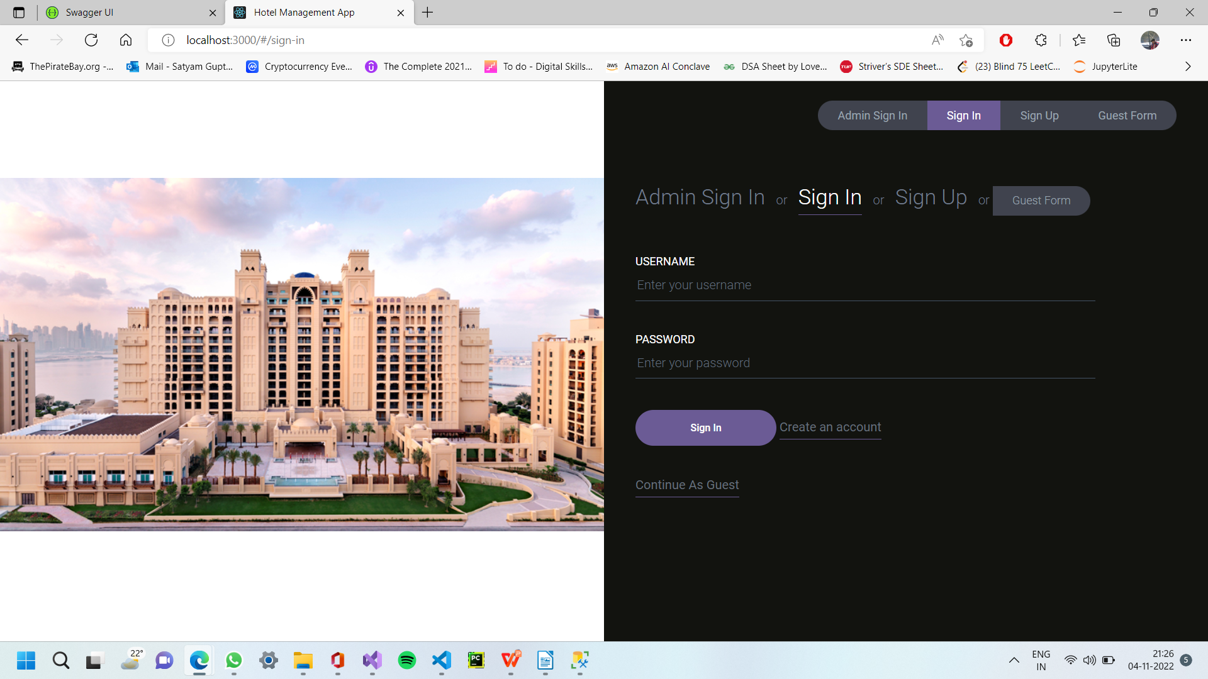
LOGIN PAGE

Slide 9
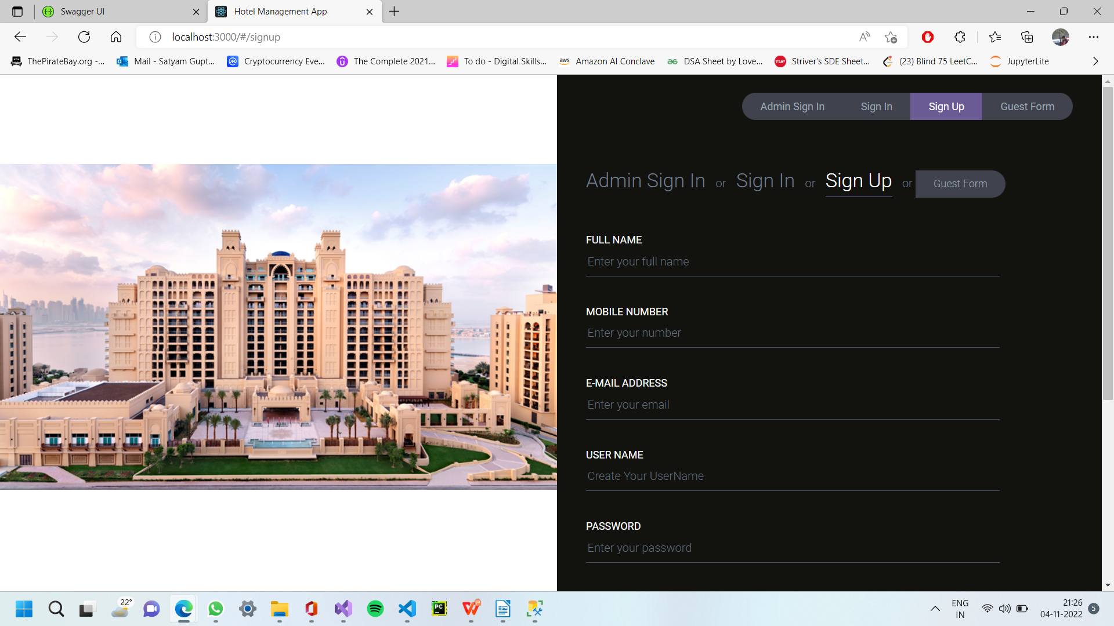
SIGN UP PAGE

Slide 10
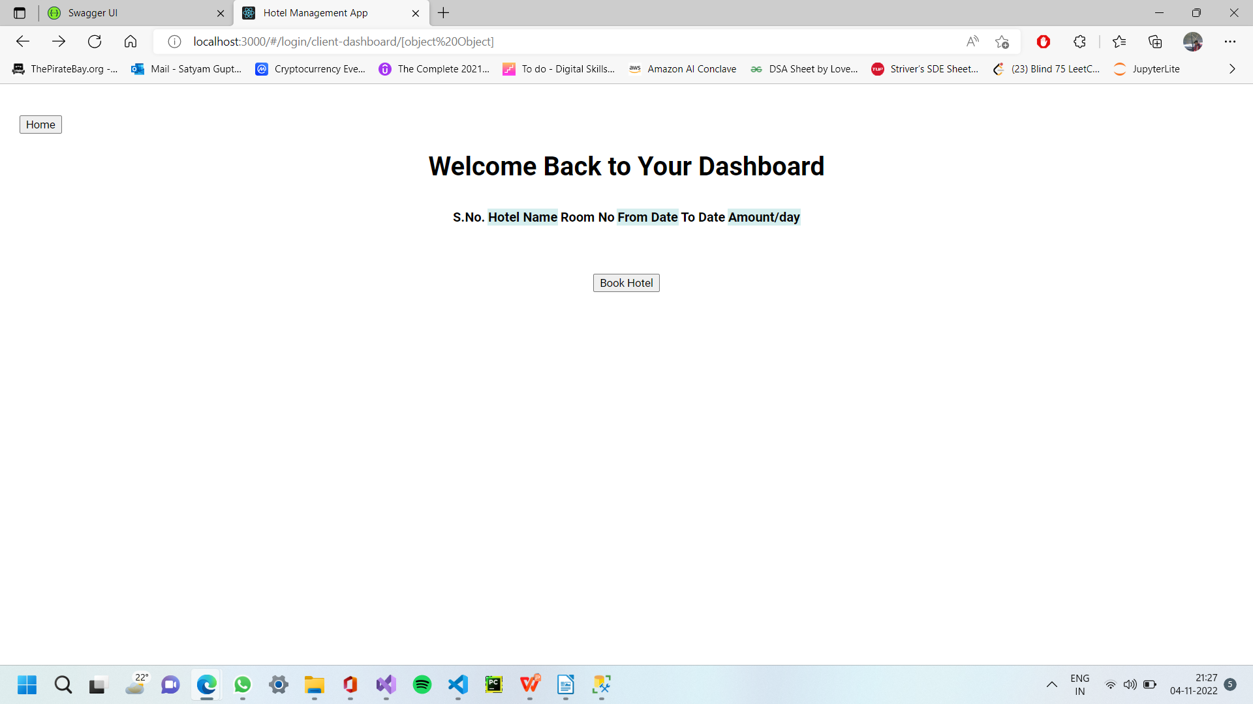
ADMIN PAGE

Slide 11
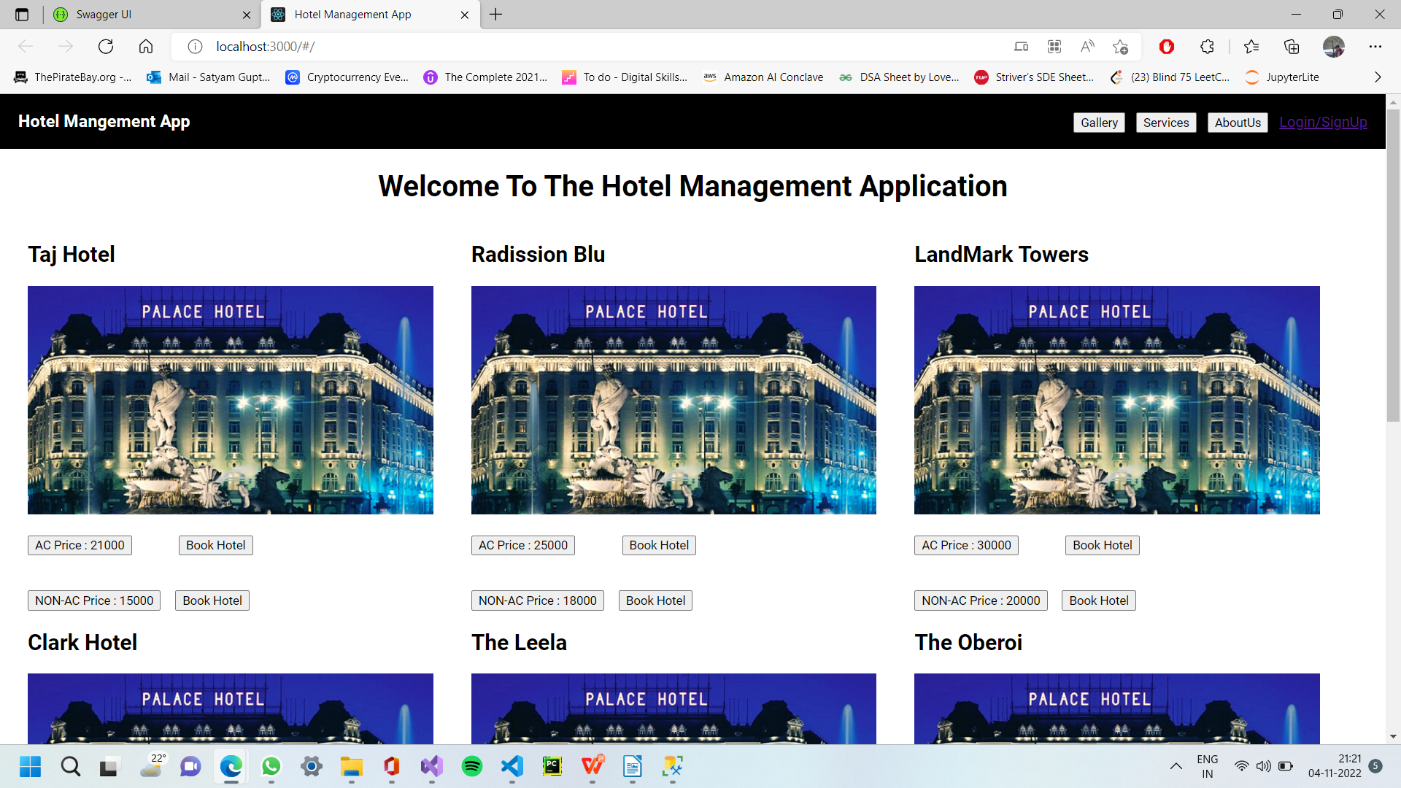
ROOM TYPE & ROOM CATEGORY

Slide 12
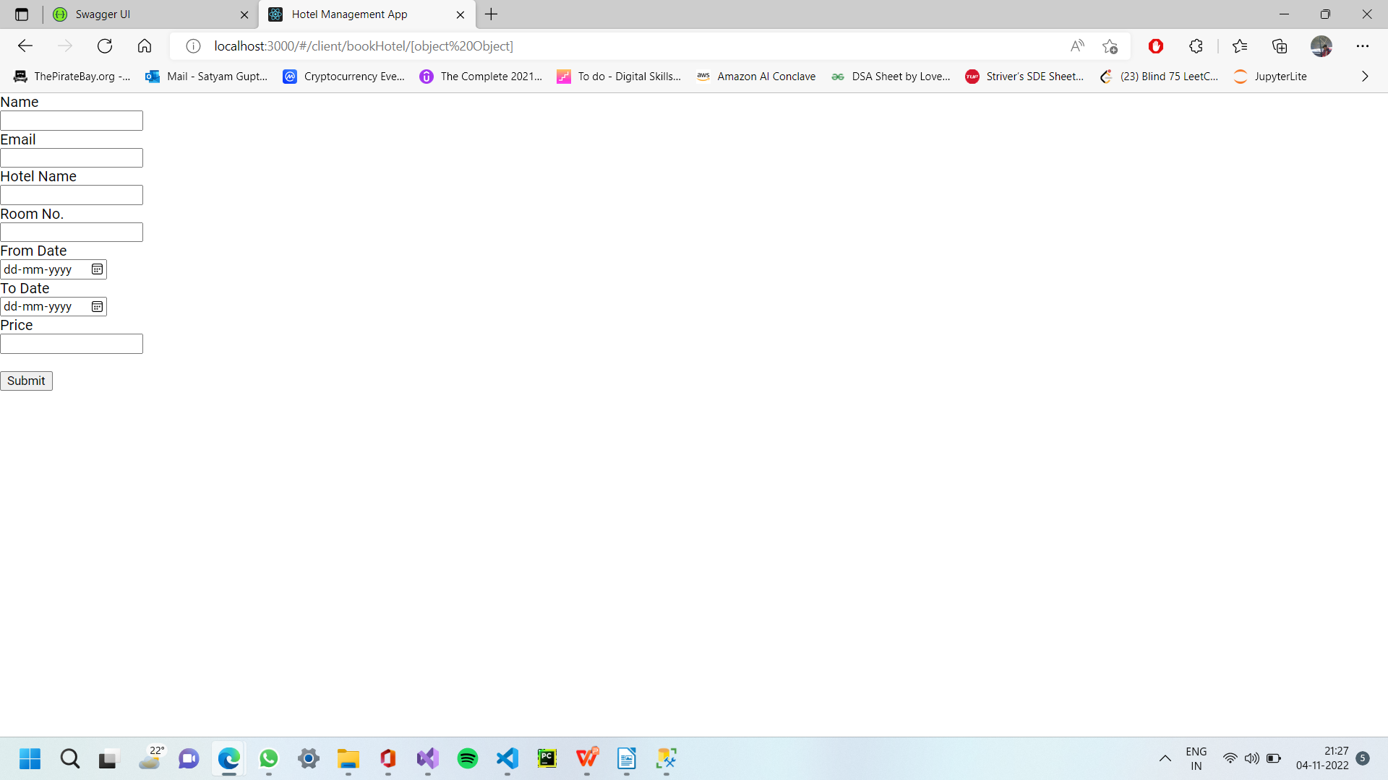
HOTEL BOOKING

Slide 13
CONCLUSION
It has been a matter of immense pleasure, honour and challenge to have this opportunity to take up this project and complete it successfully.While developing this project I have learnt a lot about hotel management, I have also learnt how to make it user friendly (easy to use and handle) by hiding the complicated parts of it from the users.During the development process I studied carefully and understood the criteria for making a software more demanding, I also realised the importance of maintaining a minimal margin for error.

Slide 14
THANK YOU!!

